Slide 1
What is secularism?
What is secularism?

Slide 2
Religious demographics in UK Population census of 2001 shows that 71.6% people self-professed to be Christian. In 2011 that number dropped to 59.5% and the number of other world religions and non-religious worldviews has increased. Recent surveys show that this trend is increasing rapidly with increased numbers non-religious, of different religious minorities, but also diversity among Christians themselves with different Christian denominations.
What is secularism?

Slide 3
Religious demographics in UK In 2015 YouGov survey has found that 49% were saying they are Christian while 42% say they have no religion. Given the trends we can expect that non-Christian minorities rise to 10% percent and increased number of people who do not belong to any religion.
What is secularism?

Slide 4
Why is this change in religious demographics important? Increase in diversity of religious and non-religious worldviews means that we need to think about how should we organise our society so it is fair for all groups. This is something that was always important but even more increasingly today. And this is where secularism comes in - it is the idea that all worldviews should be given equal playing field and the same rights and freedoms without anyone being discriminated.
What is secularism?

Slide 5
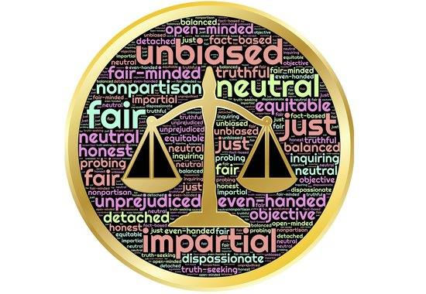
At its most basic level secularism simply entails a commitment to neutrality on the part of the state toward religious affairs, a commitment that the state should neither favor, disfavor, promote, nor discourage any particular religious (or nonreligious) belief and viewpoint over another.
So, what is secularism then?

Slide 6
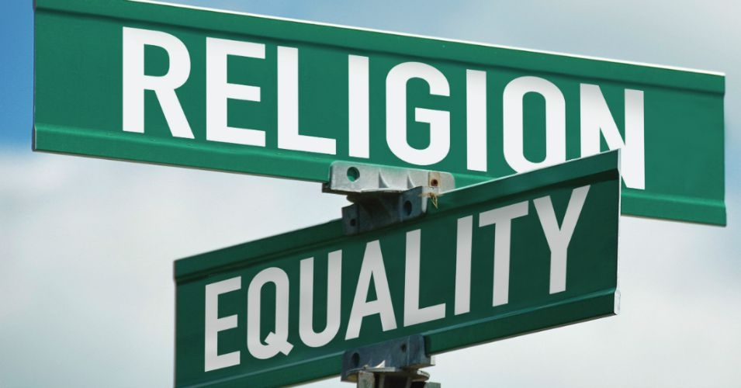
Simply because when the state promotes one religion or belief system over the other (by giving it a special position of importance and influence and funding its organisations), it creates a privilege for it, and at the same time it indirectly discriminates towards other religions, or those without religion who don’t get the same treatment. Secularism is a commitment to equality of religion or belief that can only occur if the state commits to neutrality and separation of the Religion and the State.
Why should the state not favor one religion over the other?

Slide 7
Secularism does not equate to atheism or antitheism. It does not want to remove religion from the public space (although some might argue that some negative forms of religion should be restricted from public space). It wants religious people and organisations to participate in public space on an equal playing field without any group receiving special privileges and for this reason both atheists and followers of a religion can both be secularist. In order for that to happen 3 principles of secularism need to be met.
What secularism isn’t?

Slide 8
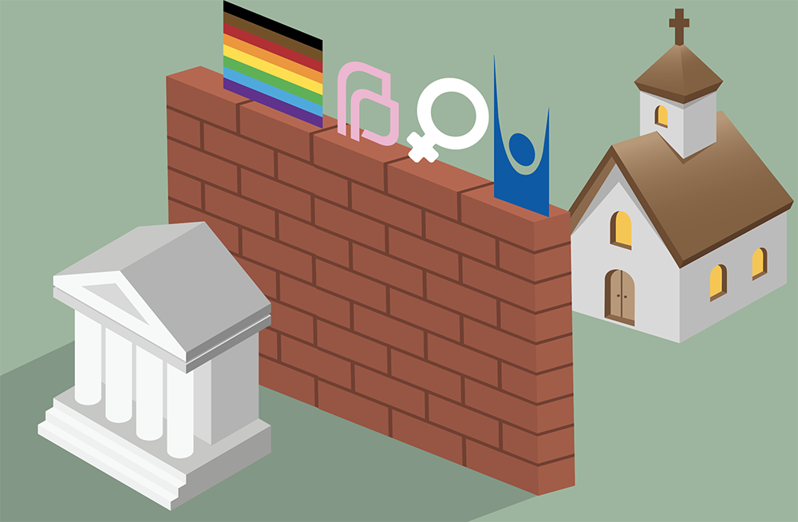
1. Separation 2. Freedom 3. Equality
What are the 3 principles of secularism?

Slide 9
1. Separation of religious institutions from state institutions and a public sphere where religion may participate, but not dominate.
What are the 3 principles of secularism?
What is secularism?

Slide 10
What are the 3 principles of secularism?
2. Freedom to practise your faith or beliefs without harming others, or to change it or not have one, according to your conscience.
What is secularism?

Slide 11
What are the 3 principles of secularism?
3. Equality, so that your religious beliefs or lack of them doesn’t put others at an advantage or a disadvantage.
What is secularism?

Slide 12
State and religion

Slide 13
Why does secularism matter?
Secularism raises significant questions about how we balance freedom of, and from, religion with other rights. These are some of the most important questions which arise in all of the humanities, from religious and belief education to citizenship, and from the arts to history.
What is secularism?

Slide 14
Why does secularism matter?
Whenever we consider questions about the influence of religion in society or our laws, the nature or limits of freedom of belief, or the balance between rights, we are following in the footsteps of secularist philosophers.
What is secularism?

Slide 15
Are you a secularist?
If you value equality of people no matter their religion, belief or lack of a belief, then you might be a secularist.
If you value freedom of and from religion as every human’s right of choice to choose what they believe in without coercion, then you might be a secularist.
If you dislike that some religious or non-religious have special privileges based on their religion or a belief, then you might be a secularist.
What is secularism?

Slide 16
Finally, have a look at some work of the National Secular Society that works for equality and freedom of religion for all.
What is secularism?

