Slide 1
Art and secularism

Slide 2
Art and secularism
How does art challenge religious privilege, tolerance, and discrimination?

Slide 3
Vocabulary
Parody
A humorous or satirical imitation of a serious piece of literature or artwork
Satire
The use of irony, sarcasm, ridicule in exposing, denouncing, or deriding vice, folly

Slide 4
The Creation of Adam
The Creation of Adam is a painting by Italian artist Michelangelo, which forms a key part of the Sistine Chapel's ceiling, painted c. 1508–1512.
It depicts the Biblical creation narrative from the Book of Genesis in which God gives life to Adam, the first man.
First discuss the original image and its meaning within the context of Christianity. What does it depict and what impact would it have had on worshippers sitting beneath it and looking up?

Slide 5
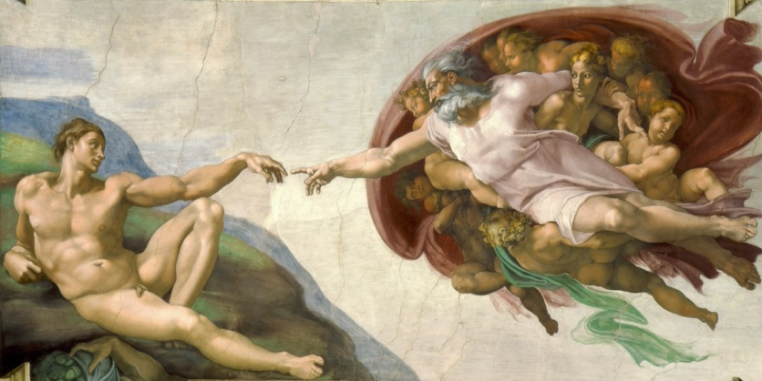
What does it depict and what impact would it have had on worshippers sitting beneath it and looking up?

Slide 6
The Flying Spaghetti Monster
The next slide depicts The Flying Spaghetti Monster who is the god of the Church of the Flying Spaghetti Monster (or Pastafarianism) - a group that encourages a unique view of religion and was created to oppose the teaching of creationism to school children in the United States in 2005.
Many followers of the FSM wear pasta strainers on their heads in homage to their god and endeavour to be nice everyone. ‘Believers’ end their prayers with ‘r-amen’ rather than ‘a-men’.
So, is the Church of the Flying Spaghetti Monster just a joke? In one way it is, but for Bobby his ‘religion’ represents many very important principles. In an open letter explaining his thoughts on his new ‘religion’, Henderson explains that if creationism is to be taught alongside evolution, so should the belief that a Flying Spaghetti Monster created the universe.

Slide 7
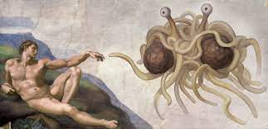
The Flying Spaghetti Monster

Slide 8
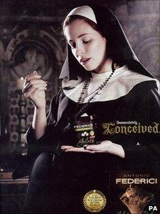
Antonio Federici
Antonio Federici's Ice Cream’s advert presented a pregnant nun eating ice cream in a church alongside the slogan "immaculately conceived". The Advertising Standards Authority banned it, saying it mocked Catholic beliefs.
Antonio Federici Ltd said the idea of "conception" represented the creation of their ice cream. It went on to say that the use of religious imagery represented its passion for its product. The firm said it also wished to "comment on and question, using satire and gentle humour, the relevance and hypocrisy of religion and the attitudes of the church to social issues".

Slide 9
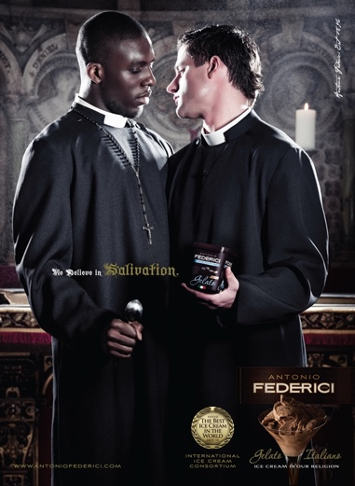
Antonio Federici
The ASA said in its ruling: "We considered the use of a nun pregnant through immaculate conception was likely to be seen as a distortion and mockery of the beliefs of Catholics. We concluded that to use such an image in a light-hearted way to advertise ice cream was likely to cause serious offence to readers, particularly Catholics."
The ASA banned another advert for Antonio Federici in July 2009 that showed a priest and a nun appearing as if they were about to kiss.

Slide 10
The Satirical Approach to Religion
Throughout history, satirists have mirrored and poked fun at the society that surrounds them. Satirists feel that they have a moral imperative to emphasise and draw attention to, the hypocrisies of the period in which they work.

Slide 11
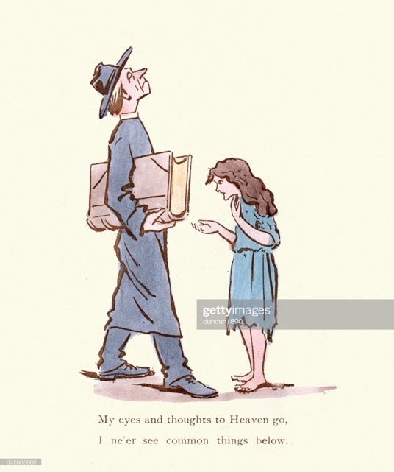
The Satirical Approach to Religion
Martin Anderson, (1854 – 1932), better known by his pseudonym Cynicus, was a Scottish artist, political cartoonist, postcard illustrator, and publisher. To the left is one of his early satirical cartoons, ‘My eyes and thoughts to Heaven go, I ne'er see common things below…’
A play on a line from Shakespeare, the satirical message of this cartoon can be taken in different ways. Victorian satirists started to question political, social religious excess and hypocrisy. This cartoon shows a vicar strolling with a large bible whilst looking up to the sky. Directly in front of him a poor looking young girl puts out her hand as if asking for money, although the vicar does not seem to see her – he is too busy looking towards the heavens.

Slide 12
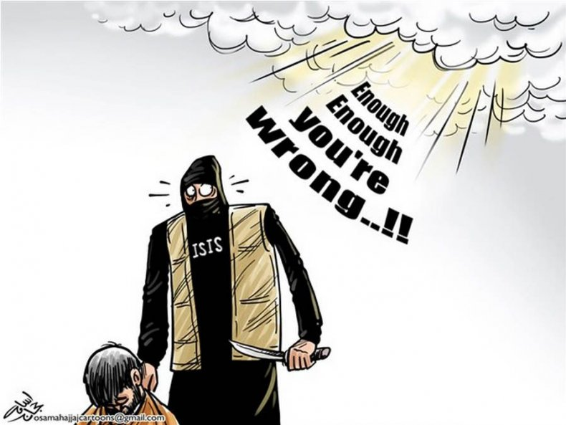
The Satirical Approach to Religion
Comics have been a key element of the Arab world since the early 20th century, and today a flourishing group of Muslim cartoonists living across the world regularly comment on political and cultural events.
Muslim cartoonists across the Middle East have bravely criticised ISIS through artwork and cartoons.
In the cartoon ‘God and ISIS’ by Osama Hajjaj, God appears and intervenes in an impending brutal murder by directly speaking to a surprised-looking ISIS fighter. The message is clear – Hajjaj does not believe that his God approves of the extremist behaviour of ISIS and their allies.

Slide 13
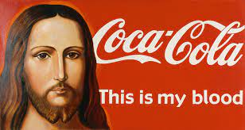
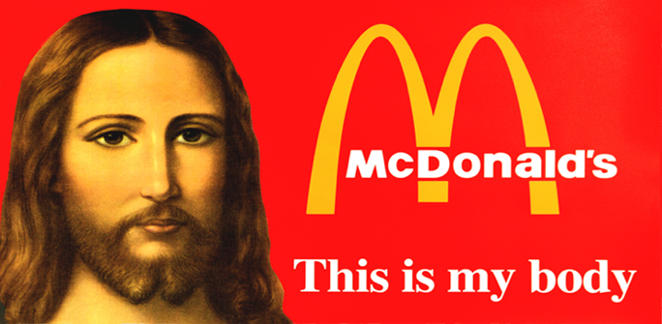
‘This is my bloody – this is my body…’
In the early 2000s a collection of canvases entitled "This is my blood / This is my body" by Alexander Kosolapov created outrage amongst many Christians. Jesus is positioned alongside McDonalds and Coca Cola logos.
"There was public condemnation of my exhibition," he said. "My work was called extremist...I was not myself called extremist," he clarified, "but I had to explain to a court the cultural and political meaning of my work.“
Kosolapov compares materialistic culture with religious iconography combining the imagery from both in his work.

Slide 14
Discuss These Viewpoints - 1
“The whole point of art is freedom of expression. I don’t believe in any form of censorship – art should offend – that’s its job – if it doesn’t offend then it’s just bland wallpaper. Let me make myself clear, nothing should be off limits in art – it should always challenge the establishment and the status quo…”

Slide 15
Discuss These Viewpoints - 2
“I think there should be some limits to what these so-called artists do – I mean there was one bloke who just pickles sharks and charges millions for them – and you shouldn’t be able to just upset people for the sake of it either – religion means a lot to some people so leave it alone!”

Slide 16
Discuss These Viewpoints - 3
“I find the whole debate very difficult…I don’t want to put rules on art but then I don’t want to offend people either…and so much of this conceptual art is so difficult to understand…what does the law say about it?”

Slide 17
Discuss These Viewpoints - 4
“The only art to be allowed should be religious and only representing the one, true religion… and it should be very respectful and only allowed to be shown in our holy buildings…”

Slide 18
Task
Split into four groups
Discuss and answer the questions on the handouts.

