Slide 1
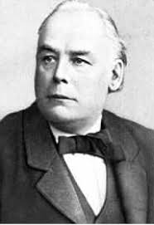
Charles Bradlaugh’s Struggle to Enter Parliament Exploring Secularism – KS2
What role has secularism played in British history?

Slide 2
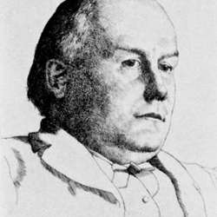
Charles Bradlaugh
Charles was born in London in 1833.
He was the son of a poor legal clerk.
As a child he liked to ask questions although this often got him into trouble.
Q. Have you ever asked a question that got you into trouble?
Q. What could Charles have asked about that got him into so much trouble that he was told to leave his job as a Sunday school teacher, and that caused his father to make him leave home?

Slide 3
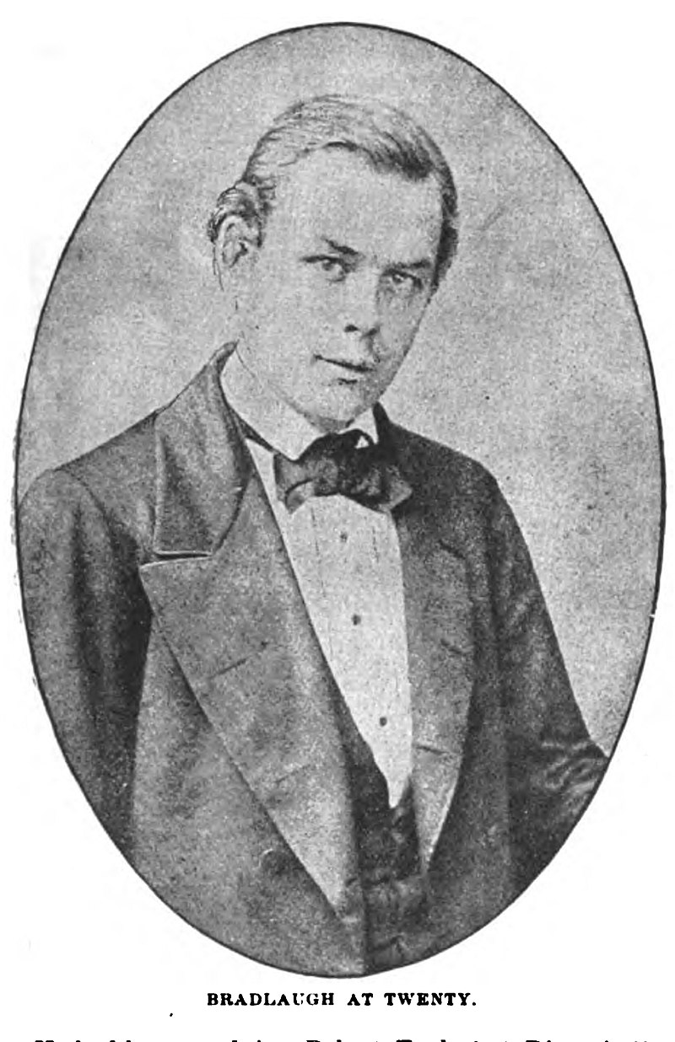
The Young Charles
As a young Sunday school teacher, Charles found he didn’t understand or believe some of the things he read in the Bible
He wrote to the Reverend John Graham Packer and asked him to explain some inconsistencies and things he was struggling to understand.
Instead of helping Charles, the Reverend Packer reacted very angrily and spoke to Charles’ father.
Charles told his father that he no longer believed in religion.
Charles’ father told Charles that he must change his mind – or leave home.

Slide 4
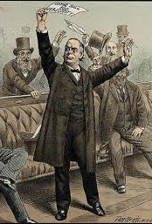
Charles the Orator
In the years that followed he began to write and speak publicly on a range of subjects including women's rights and atheism (the lack of belief in the existence of God). He became famous for his public speaking and could attract audiences of thousands.
Primary Sources of Evidence:
“I heard Bradlaugh speak, and I can see him now as he stood on the platform. He was a massive figure, with a fine head and a powerful voice, and in declamation he was a tremendous force".
"I remember, as clearly as though it were only yesterday, the immediate and compelling impression made upon me by that extraordinary man. I have never been so influenced by a human personality as I was by Charles Bradlaugh. The commanding strength, the massive head, the imposing stature, and the ringing eloquence of the man fascinated me..."

Slide 5
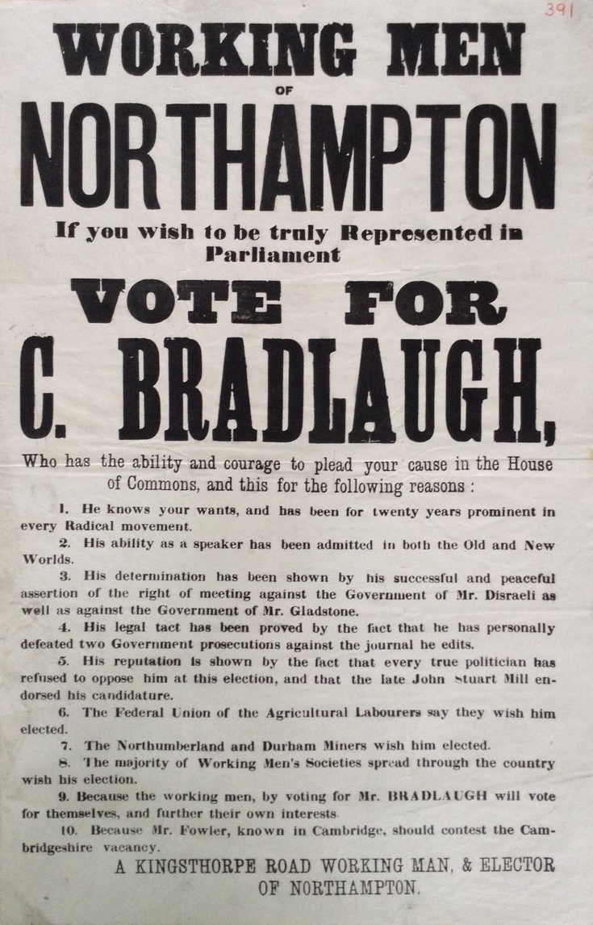
Charles is Elected!
Q. What impact did listening to Charles speak have on the two listeners - why were they so impressed?
Charles now had thousands of people coming to hear him talk and in 1868 he decided to stand for election for the Northampton constituency. He wanted to try and change things through politics – through being an MP.
Charles was elected by the men of Northampton (women were not allowed to voute until 1918and didn’t have equal voting rights until 1928).

Slide 6
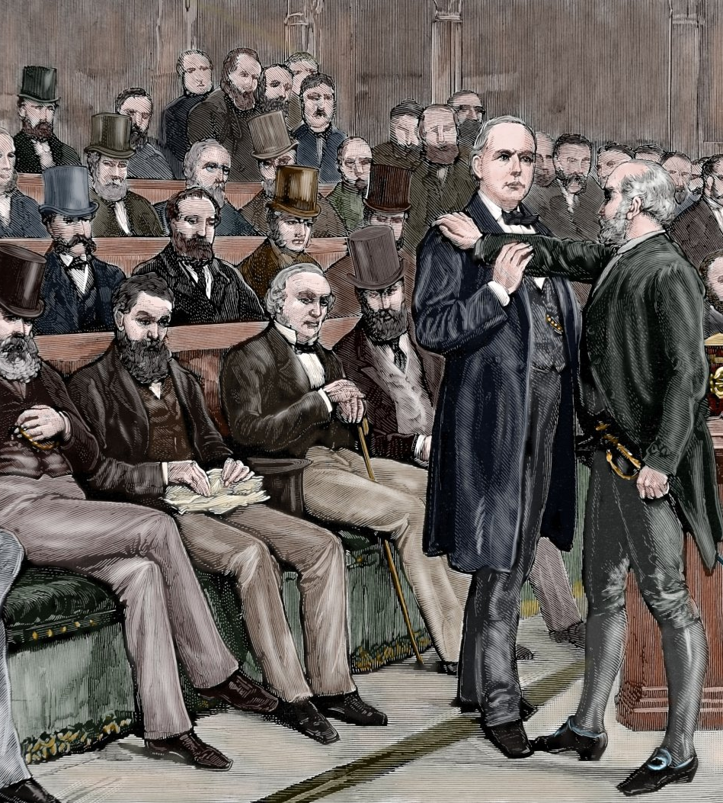
Parliament says No!
As an atheist and republican he preferred not to take an oath of allegiance to God and the Queen as the words of the oath were meaningless to him.
Because of his atheist beliefs he was effectively barred from taking his seat in Parliament.

Slide 7
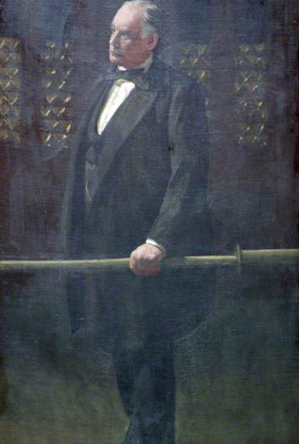
Six Long Years of Stuggle
It took nearly six years for Charles to eventually take his seat in Parliament. During this time he was reelected several times as the MP for Northampton but was never allowed to take his seat.
Four times his constituents re-elected him; four times he made passionate speeches at the Bar of the House. The Bar marked the boundary of the House – he was allowed to speak to MPs there, because he was not strictly within the House of Commons.

Slide 8
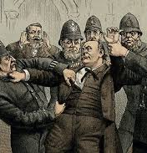
Arrest & Prison
On one occasion he refused to leave Parliament when told to do. He was forcibly taken by officials and held in prison before being released the next day.
On another ocassion, Charles came to the House of Commons at the head of an enormous crowd demanding that he be allowed to take his rightful place. He was thrown out by the police, suffering injuries in the process. Despite this injustice he spoke to the angry crowd and told them to leave peacefully.

Slide 9
Charles Takes His Seat in Parliament
Eventually Charles was allowed to take his seat in Parliament. After the General Election of 1885 a new Speaker took the decision of allowing Bradlaugh to take the oath, which he did on 13 January 1886. Almost six years after being first elected, Charles had won.
His victory was further underlined by Parliament passing an Oaths Act (1888) which extended the civil rights of freethinkers and secured the their right to affirm when taking their seat in parliament. Many MPs take advantage of this today.

Slide 10
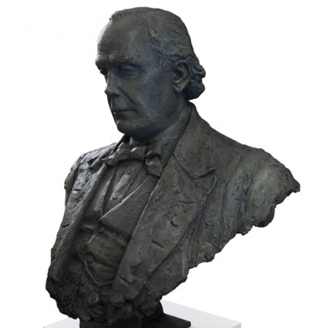
Questions
Can you explain why Charles Bradlaugh’s eventual entry into Parliament was a significant turning point in British history?
What would the situation be in Parliament today if Charles had not fought against the establishment? Would we have such a wide range of people as our MPs?
Can you think of, or research, some reasons that the political establishment might have wanted to keep Charles out of Parliament.

