Slide 1
What is secularism?
KS2 / KS3 What is secularism?

Slide 2
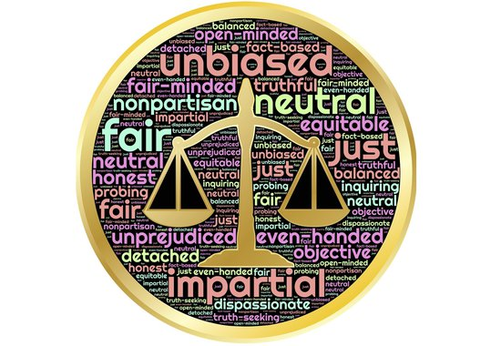
The separation of religion from the State The separation of religion and politics is the foundation of secularism. It makes sure religious groups don't interfere in political decisions, and the state doesn't interfere in religious affairs. Q. What is the State? Q. Can you give an example of a political decision? Q. Why is it a good idea to keep politics and religion separate?
What is secularism?

Slide 3
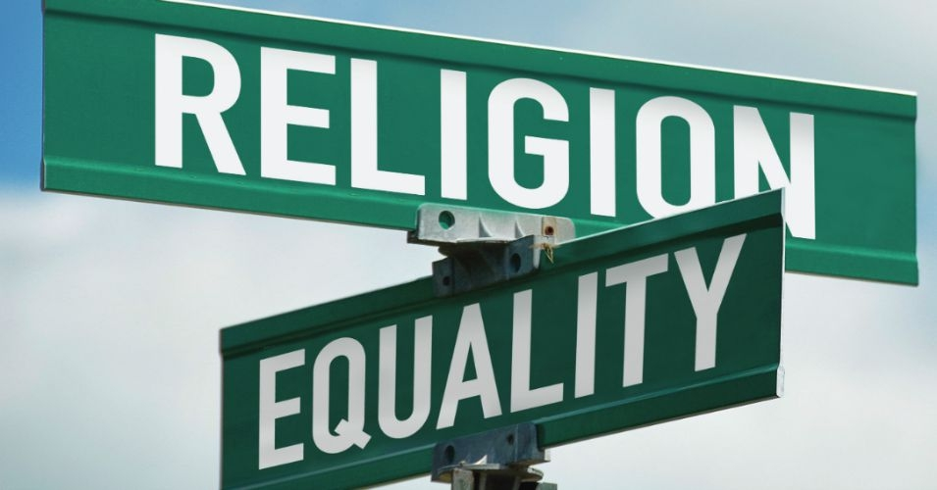
Simply because when the state promotes one religion over another (by giving it a special position of importance), it creates a privilege for it and at the same time it indirectly discriminates towards the other religions or those without religion who don’t get the same treatment. Secularism is a commitment to equality of religion or belief that can only happen if the State commits to neutrality and separation of the Church and the State. Q. Can you explain what privilege is? Q. What does ‘commit to neutrality’ mean? Q. Why might it be problematic to give one religious group privilege?
Why Should the State not Favour one Religion Over Another?

Slide 4
Secularism is not the same as atheism. It does not want to remove religion from the public space. It wants religious people and organisations to participate in the public space on a level playing field without any group receiving special privileges and for this reason both atheists and followers of a religion can both be secularist. Q. What is atheism? Q. What does the metaphor, a ‘level playing field’ mean? In order for that to happen, 3 principles of secularism need to be met.
What secularism isn’t?

Slide 5
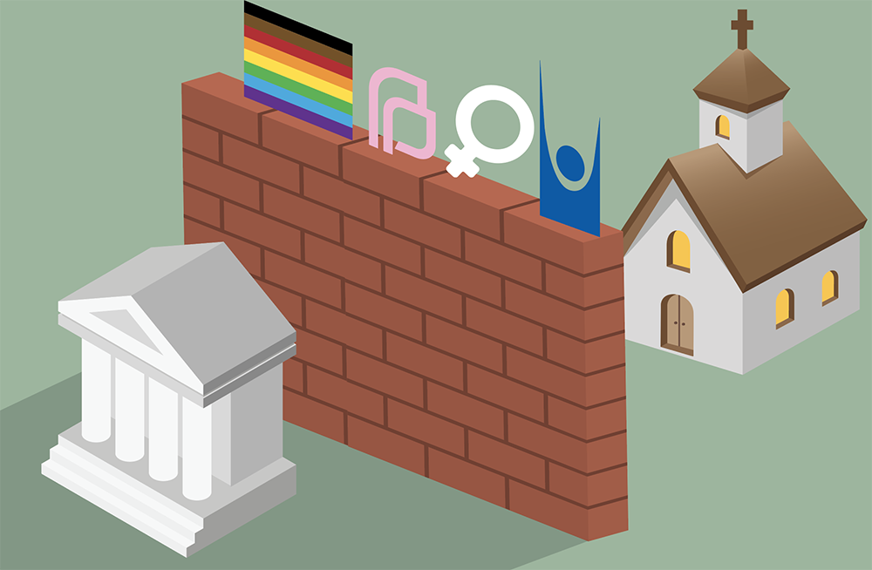
1. Separation 2. Freedom 3. Equality
What are the 3 principles of secularism?

Slide 6
1. The Separation of religious groups from the state and a public sphere where religion may participate, but not dominate.
What are the 3 principles of secularism?
What is secularism?

Slide 7
2. Freedom to practice your faith or beliefs without harming others, or to change it or not have one, according to your conscience.
What are the 3 principles of secularism?
What is secularism?

Slide 8
3. Equality, so that your religious beliefs or lack of them doesn’t put others at an advantage or a disadvantage.
What are the 3 principles of secularism?
What is secularism?

Slide 9
Why Does Secularism Matter?
In a modern, pluralist society such as the UK, it is important that everyone feels their viewpoints are listened to and people feel that they are treated equally. Secularists believe that ,just because you believe in a certain religion, you should not be given advantages via the State.
Q. What does pluralist mean?
Q. Think about a time that you were treated unfairly – how did it feel?
Q. Why is it important that individuals and groups within society don’t feel unfairly treated?
What is secularism?

Slide 10
Are you a secularist?
If you value equality of people no matter their religion, belief or lack of a belief, then you are a secularist.
If you value freedom of religion as every human’s right of choice to choose what they believe in without force, then you are a secularist.
If you dislike that some religious or non-religious have special privileges based on their religion or a belief, then you are a secularist.
What is secularism?

Slide 11
Finally, have a look at some work of the National Secular Society that works for equality and freedom of religion for all.
https://www.secularism.org.uk
What is secularism?

